Slide 1

LODZ UNIVERSITY OF TECHNOLOGY
Filip Rynkiewicz

Slide 2
Education
Lodz University of Technology
Faculty of Technical Physics, Information Technology and
Applied Mathematics
First-cycle studies:
  Full-time,
  Specialization: Computer Simulation and Games Technology
  The final grade: good
Second-cycle studies:
  Full-time,
  Specialization: Interactive Systems and Games Technology
  The final grade: very good

Slide 3
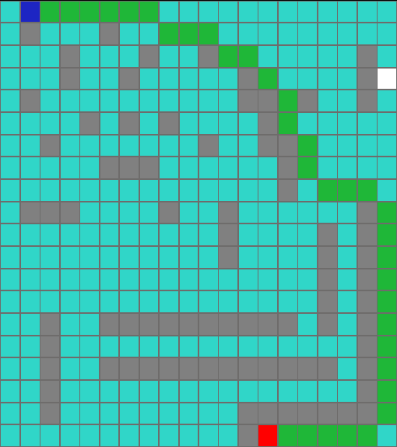

Bachelor’s thesis
“CPU and GPU approach to path finding algorithm”
Notes:
In my Bachlor’s thesis I was trying to speed up Pathfinding Algorithms using Cuda framework. Nvidia technology allow user to create own functions which will be executed directly on GPU, on multiple GPU cores simultaneously. Data allocated on CPU must be forwarded to GPU, and after computation send back to GPU. This is the most time-consuming action, because data must be send from one physical device to another. In addition pathfinding algorithms creating data in every iteration, but allocation of this data must be at the CPU side, so you must allocate maxiumum amount od data, and sand it in every iteration. In conclusion my implementation on GPU was few times slower than on CPU.

Slide 4
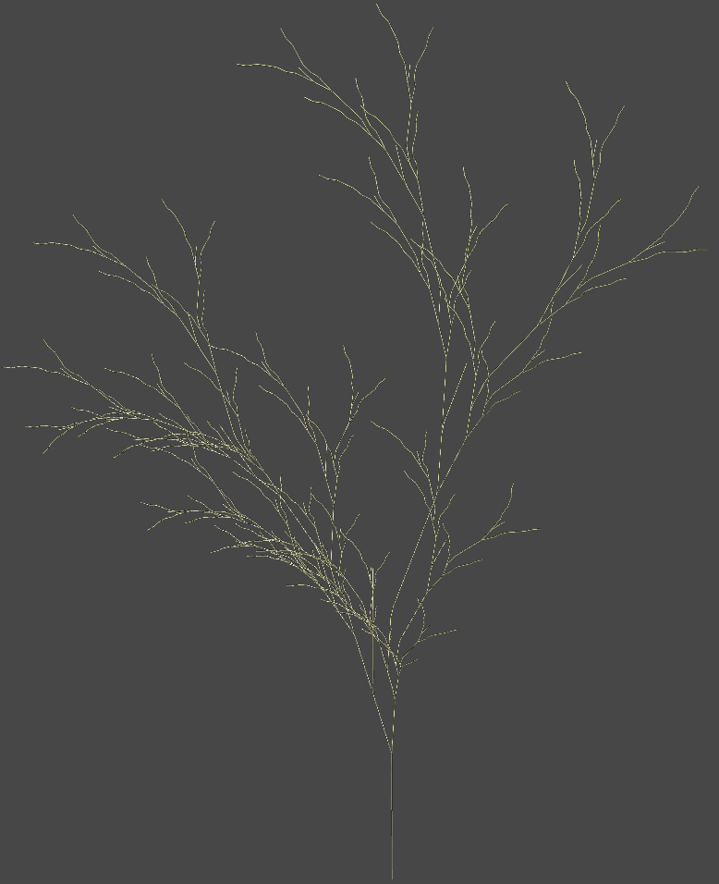
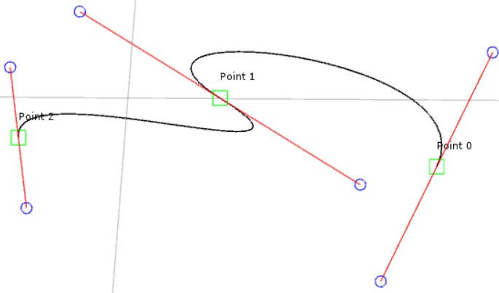
Master’s thesis
“Implementation and usage of Lindenmayer System in creation of artificial plants”
Notes:
My idea of master thesis have started from the simple thought of creating tree proceduraly. I have started to look algorithms in internet and I have found Lindenmayer Systems. I have implemented simply 2d L-system in C++ SMFL. But I wanted to creating something bigger. First using Unreal Engine 4 to port my previous application, then because of the bugs on UE4 to UNITY5. In there I stared to develop more and more features to my L-system implementation.I have created simple 3d tree model, but how I suppose to change one branch without 3d modeling softwere. In the base of every branch there is a line, so first thougth Bezier Curves. In conclusion I have implemented Parameteric L-system with edition by Bezier Curve. To create tree with 400 branches and multiple parameters algorithm need less than 2 seconds.

Slide 5
Publications
F. Rynkiewicz. ”Procedural generation of plants” 2016
Notes:
In this year at ZTGK at the CGI Conferency I had the pleasure to share some information abouth my Master’s thesis with other preople. The article from this topic will be publish in post conference publication.

Slide 6
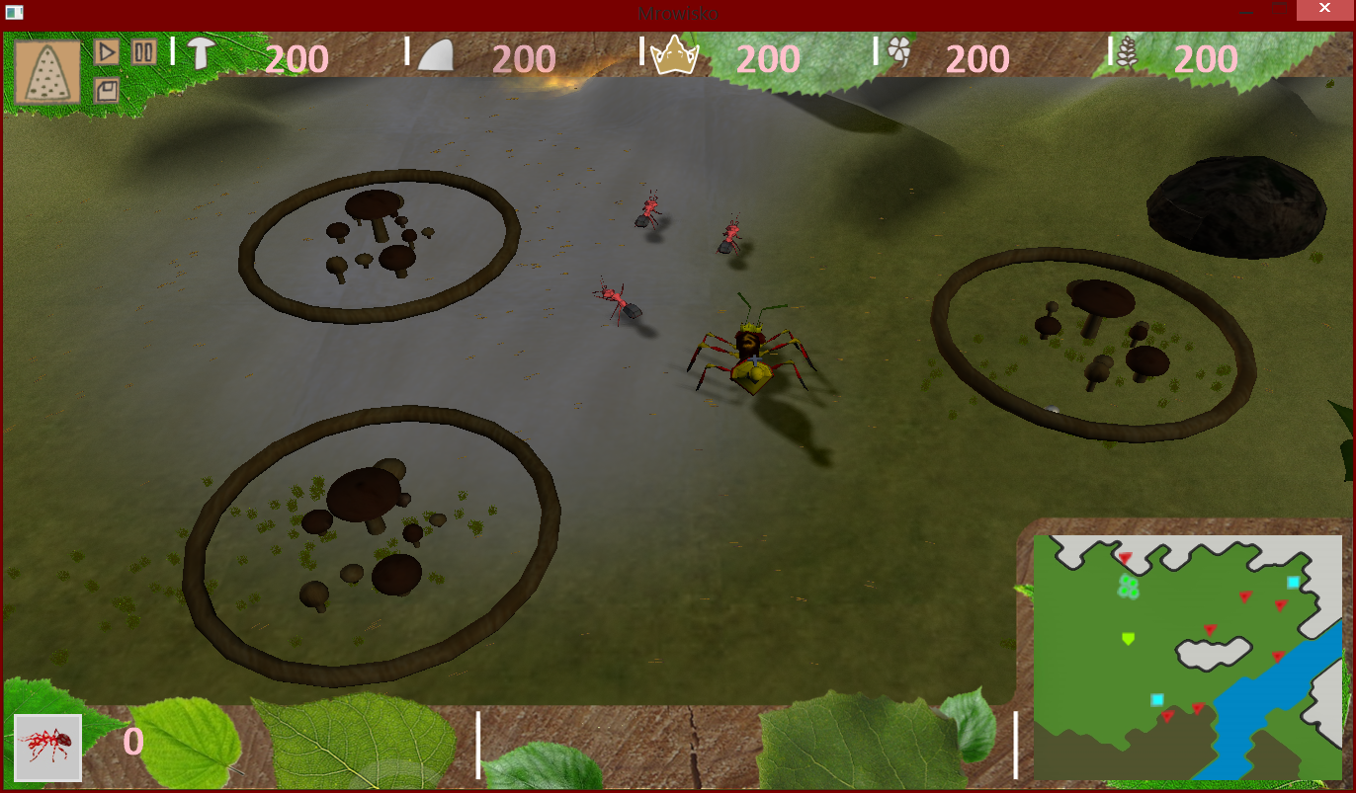
Achievements
Award for “Originality of created world and solutions” at ZTGK 2014.
Notes:
In 2014 My team was awarded for “Orrir” from Wasteland Interactive. This contest consist of craeting game engine based on XN framework. We have created an RTS game about ant’s life. Thanks to this my and my friend had chance to work in real gamedeveloping company.

Slide 7
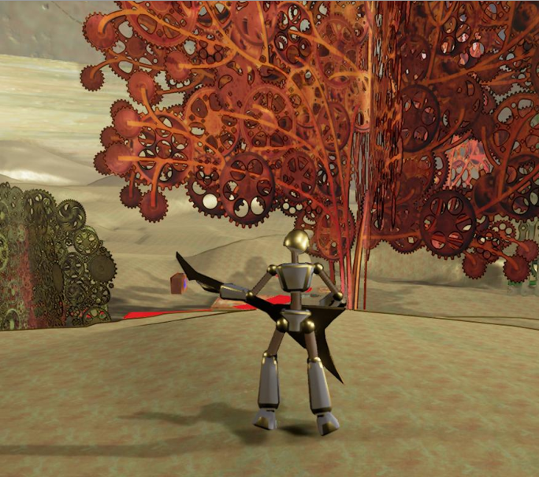
Imagine Cup. Business Acceleration Days. Games
Notes:
In 2016 our project “Gears of Time” had been qualificated to Imagine Cup in games area. Using Unreal Engine 4 we were trying to show world of gears and steam. Our here was trying to

Slide 8

Work experiance
Wasteland Interactive
Notes:
We were working in Wasteland Interactive for summer intership. For one month we developed tool for unit edition in game WorldOfMagic.

Slide 9



EfektpolVR
AR\VR Programmer
Notes:
Thanks to Imagine Cup I have found yob at the gamedevlop. In EfektpolVR I was working on those 3 games. FBQ and PHBS was announced in IOS and Android, and new life was Greenlited. This work gave my experience abouth my capabiliteies and gave my chance to develop my skills in Unity C# and both Andoird and IOS stores.

Slide 10

Junior programmer
Notes:
In first of September I had started work at the Ericpol-Erricson. There im Junior programmer at Radio Facility, and I’m currently training innner Erricson Technologys.

Slide 11
Further scientific work
Doctoral thesis:
- VR and AR algorithms,
- Procedural generation,
- GPU Concurrency,
- Optimization,
- Low level programming languages.
Notes:
In my doctoral thesis I would like to be focused on one of those topics.

